Slide 1
Industrial AI & Automation Project #1
Automobile Engine Fault Diagnosis Using
Machine Learning Method
21900416 AN GYEON HEAL
21900727 JIN GA RAM
School of Mechanical & Control Engineering
10.01.2024
Industrial AI & Automation
Prof. Young-Keun Kim

Slide 2





CONTENTS
Engine Fault Diagnosis
Problem Statement
Baseline Survey
Progress Scheme
Additional Study
Background

Slide 3
BACKGROUND
Engine Fault Diagnosis
Necessity
Vehicle engine malfunctions increase emissions of harmful pollutants like CO, HC, and CO2, contributing to environmental problems.
Engine malfunctions lead to high repair costs, unexpected downtime, and potential financial and safety risks.
Engines may experience mechanical or electronic failures (e.g., sensor issues, pressure problems, injector defects), complicating the repair process.
Technical Challenges
Traditional Engine Fault Diagnosis Methods Rely on Manual Inspections and Specialized Tools (e.g., fuel pressure measurements, OBD-2 scanners).
It’s Labor-Intensive, Expensive, and Require Expert Knowledge, It’s Vulnerable to Human Error.
Solution
By Applying Machine Learning, Variables from Engine Testing Experiments can be used for Classification to Identify Types of Engine Faults.
Classification will Help Quickly Diagnose and Resolve Engine Faults, Enabling Fast and Efficient Repairs.

Slide 4
PROBLEM STATEMENT
Engine Fault Diagnosis
Objective
By Developing a Model that Outperforms those Implemented in Existing Journals,
Accurately Identify types of Engine faults, Providing Greater Speed and Precision in Engine Repairs.
Detailed Objectives
Classify Datasets by Machine Learning Model Using “EngineFaultDB” Datasets.
Understand and Analysis Datasets through Feature Analysis.
Improve Model Performance through Feature Extraction and Feature Reduction/Selection
Compare the Model Performance with Baseline Journal.

Slide 5
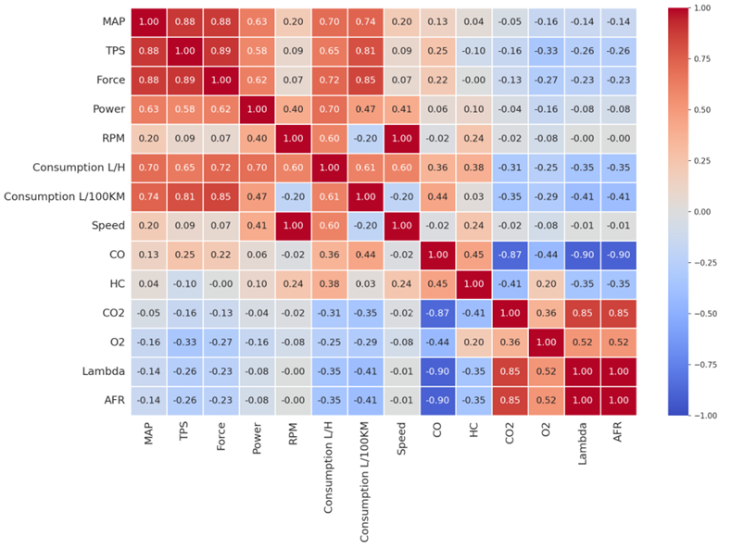

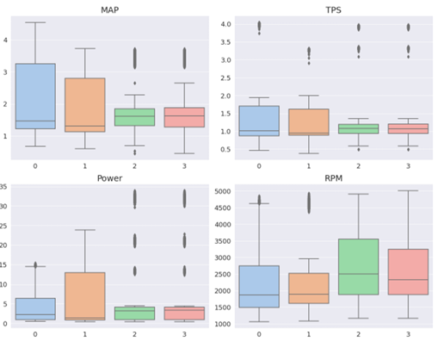
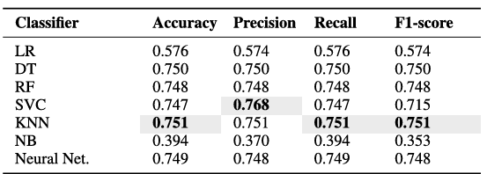

BASELINE SURVEY-JOURNAL
Engine Fault Diagnosis
Journal (IEEE): LINK
1. Correlation Analysis
3. Data Preprocessing & Classification
Logistic Regression
Decision Tree
Random Forest
SVM
KNN
Naive Bayes
Feed-Forward Neural Network
Correlation :
How variables influence each other
Multicollinearity :
Reducing highly correlated variables
Each Datasets has a different range → Scaling is necessary.
Min-Max Scaler
4. Performance Confusion Metrics
2. Box Plot Analysis
Accuracy
$$Accuracy= \frac{TP+TN}{TP+TN+FP+FN}$$
Precision
$$Precision= \frac{TP}{TP+FP}$$
Recall
$$Recall= \frac{TP}{TP+FN}$$
F1-Score
$$F1−Score=2× \frac{Precision×Recall}{Precision+Recall}$$
Data Distribution Summary
Identifying Outlier
Skewness Check
Range and Variability Check
<Performance – Testsets>
Performance of KNN = 0.751
[1] Vergara, M., Ramos, L., Rivera-Campoverde, N. D., & Rivas-Echeverría, F. (2023). Enginefaultdb: a novel dataset for automotive engine fault classification and baseline results. IEEE Access, 11, 126155-126171.

Slide 6
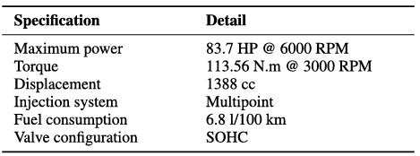
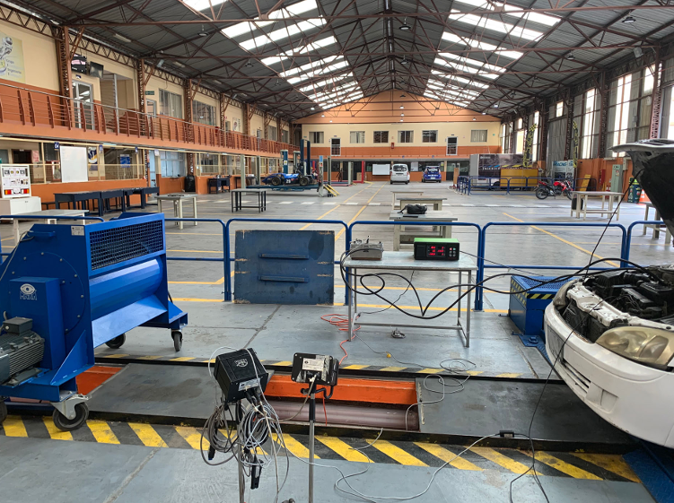
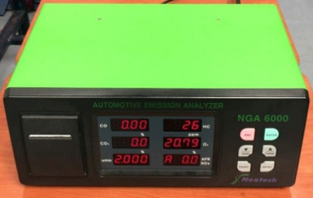
BASELINE SURVEY-DATASETS
Engine Fault Diagnosis
Datasets Name
INPUT
Datasets (Github) : LINK
EngineFaultDB (Supervised Learning)
Manifold Absolute Pressure (MAP)
Pressure inside manifold [kPa]
Throttle Position Sensor
Position of Throttle: about fuel injection, ignition time, etc. [%]
Force
Engine torque/rotational force [N]
Power
Energy transferred in engine [kW]
Revolutions Per Minute (RPM)
The times crankshaft rotates per minute
Fuel consumption L/H
Engine's fuel consumption rate
Fuel consumption L/100KM
Engine's fuel efficiency by distance
8. Speed
Vehicle's travel speed [km/h]
9. Carbon monoxide (CO)
CO concentration in the exhaust gases [%]
10. Hydrocarbons (HC)
Hydrocarbons concentration [%]
11. Carbon dioxide (CO2)
CO2 concentration : combustion efficiency [%]
12. Oxygen (O2)
Oxygen concentration : insights about combustion [%]
13. Lambda
Air-fuel equivalence ratio
14. Air-Fuel Ration (AFR)
Ratio of the air fuel in the combustion chambers
Achieved by
Mary Vergara, Diego Rivera, Francklin Rivas-Echeverría
Test Engine
C14NE Spark Ignition Engine: Petrol Engine (Gasoline)
<Test Engine Configuration>
Engine Data Collection Method
OUTPUT
Fault type 0: Normal (16,000 entries)
Fault type 1: Rich mixture - High Pressure, Incorrect Sensor, etc. (10,988 entries)
Fault type 2: Lean mixture – Low Pressure, Incorrect Sensor, etc. (15,000 entries)
Fault type 3: Low Voltage – Worn Spark, Defective Coil, etc. (14,001 entries)
<Engine Data Collection / Gas Analyzer Device>
Gas Analyzer
USB 6008 Data Acquisition Card (DAQ)
[2] Thomas, L. (2024). EngineFaultDB Dataset. GitHub. https://github.com/Leo-Thomas/EngineFaultDB

Slide 7
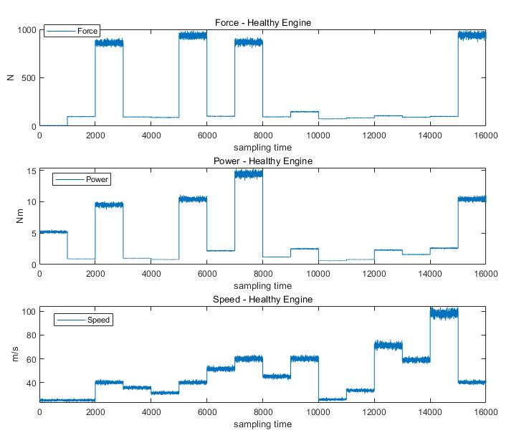
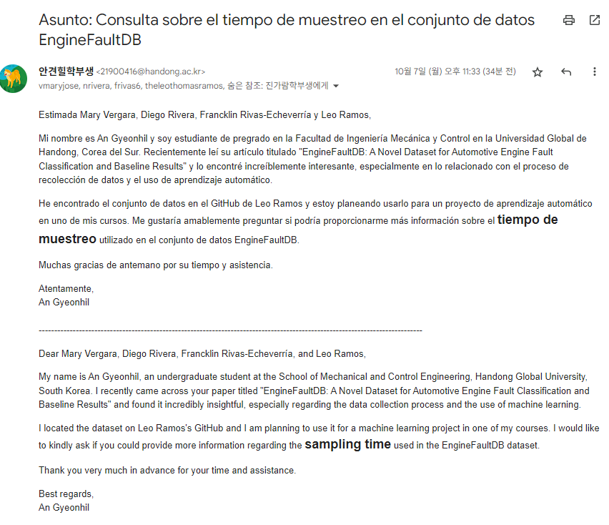
BASELINE SURVEY – DATASETS
Engine Fault Diagnosis
Experiment Period (T) = 1,000
Experiment under Various Conditions, per 1,000 periods
There’s NO Information about Sampling Time

Slide 8
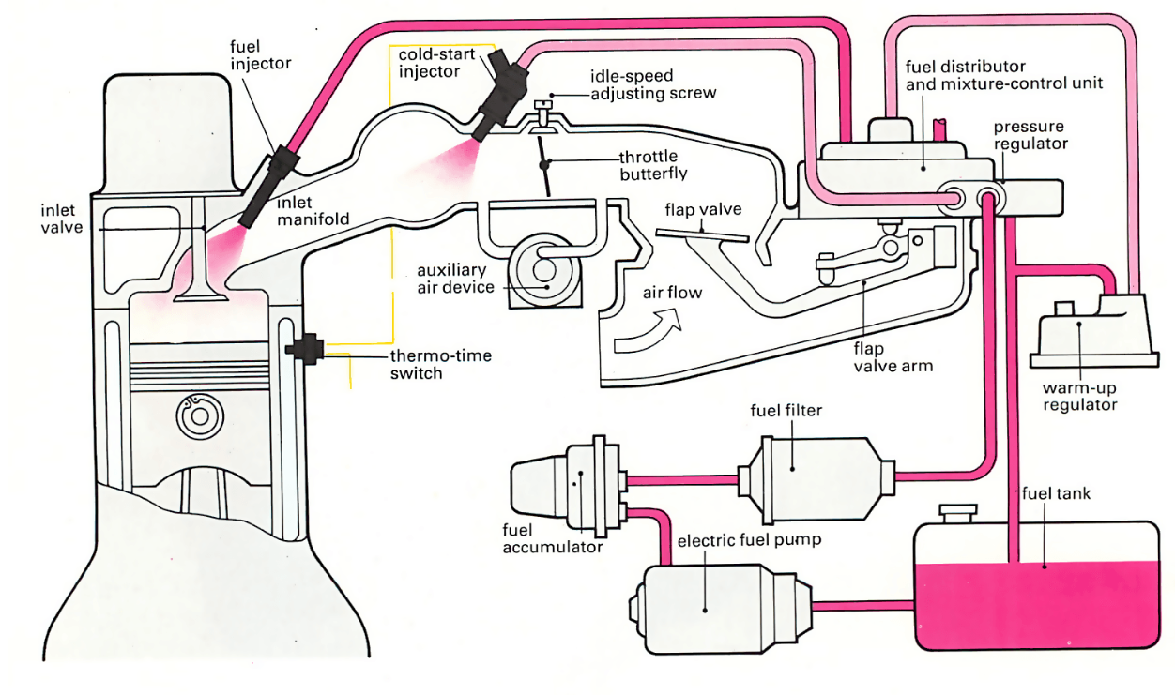
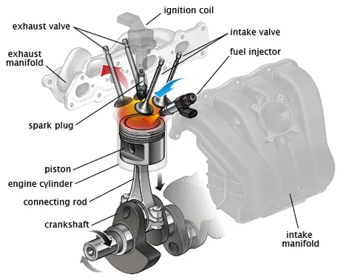
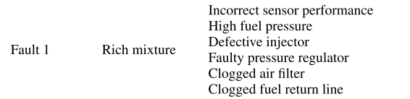


BASELINE SURVEY – FAULTS
Engine Fault Diagnosis
Fault 1
Fault 2
Fault 3
Fuel Return Line
< Ignition System >
< Lucas Mechanical Fuel Injection System (Petrol Engine) >
[3] How a Car Works. (n.d.). How a Fuel Injection System Works. How a Car Works. https://www.howacarworks.com/basics/how-a-fuel-injection-system-works
[4] RepairPal. (n.d.). Ignition Coil. RepairPal. https://repairpal.com/ignition-coil
Notes:
https://www.howacarworks.com/basics/how-a-fuel-injection-system-works

Slide 9

PROJECT PROGRESS SCHEME
Engine Fault Diagnosis
Method
Data Analysis
Preprocessing
Feature Extraction
Feature Reduction/Selection
Classification
Evaluation
Plot Data to know datasets Tendency
Remove Outlier data
Correlation Check
Extract Time-domain
Extract Frequency-domain
Analyze Kurtogram / STFT
PCA
Manual / Automatic Selection
Logistic Regression
Decision Trees
Random Forests
SVM
KNN, etc.
Accuracy
Precision
Recall
F1-Score
Expected Outcome
Schedule
Role Distribution
Derive Meaningful Information
Migrates Overfitting
Enhance Computational Efficiency
 | 1st Week | 2nd Week | 3rd Week
Data Analysis
Preprocessing
Feature Extraction
Feature Reduction/Selection
Classification
Evaluation
Writing Report
AN GYEON HEAL
Analyze about Baseline Journal
Search Engine Structure & Vulnerable Part or Process
Research about Diagnosis Process
JIN GA RAM
Search Applicable Way or Field
Search Additional Datasets
Research about Additional ML Method that can Improve Model Performance
Extracting/Reducing/
Selecting Features
GOAL
Higher Performance than Baseline Journal $(≥0.751)$

Slide 10

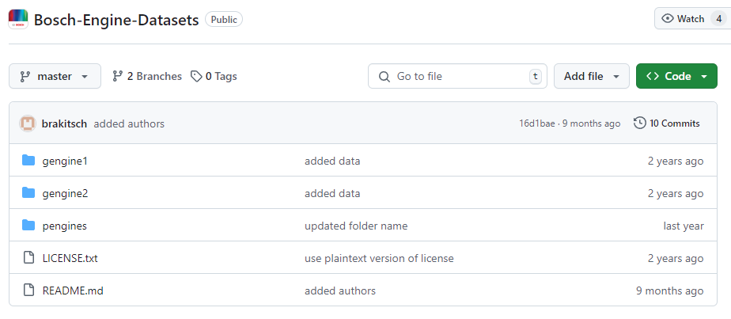
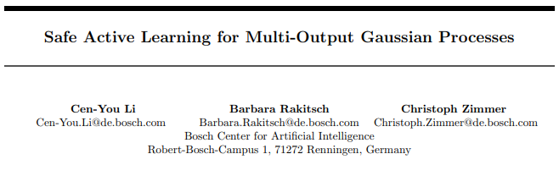
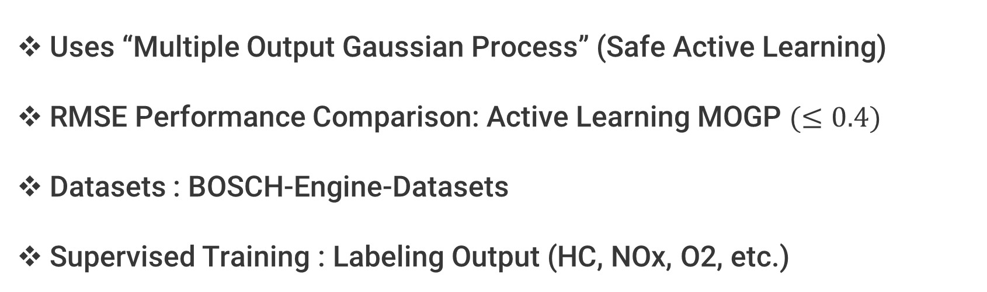
ADDITIONAL RESEARCH
Engine Fault Diagnosis
Further Study
Apply the Model to the Open BOSCH Engine Dataset Available on BOSCH’s Official GitHub.
Datasets Information
Datasets #
#1. gengine 1
Speed, Load, Lambda, Ignition Angle, Fuel cutoff, CO, CO2, HC, NOx, O2, Temperature(Manifold), Temperature (Catalyst)
#2. gengine 2
Speed, Load, Lambda, Ignition Angle, HC, NOx, O2, Temperature(Manifold), Temperature (Catalyst)
#3. pengines
engine speed, engine load, intake valve opening, air fuel ratio, specific fuel consumption, temperature exhaust manifold, temperature (Catalyst), cylinder pressure, HC, NOx
[5] Bosch Research. (n.d.). Bosch Engine Datasets. GitHub. https://github.com/boschresearch/Bosch-Engine-Datasets
Related Survey/Research
Plan
Uses “Multiple Output Gaussian Process” (Safe Active Learning)
RMSE Performance Comparison: Active Learning MOGP $(≤0.4)$
Datasets : BOSCH-Engine-Datasets
Supervised Training : Labeling Output (HC, NOx, O2, etc.)
Train ML Model which Labeled by (HC, NOx, O2, etc.) and Compare Performance
OR
Diagnose Engine Fault Using BOSCH-Engine-Datasets
[6] Li, C. Y., Rakitsch, B., & Zimmer, C. (2022, May). Safe active learning for multi-output gaussian processes. In International Conference on Artificial Intelligence and Statistics (pp. 4512-4551). PMLR.

Slide 11
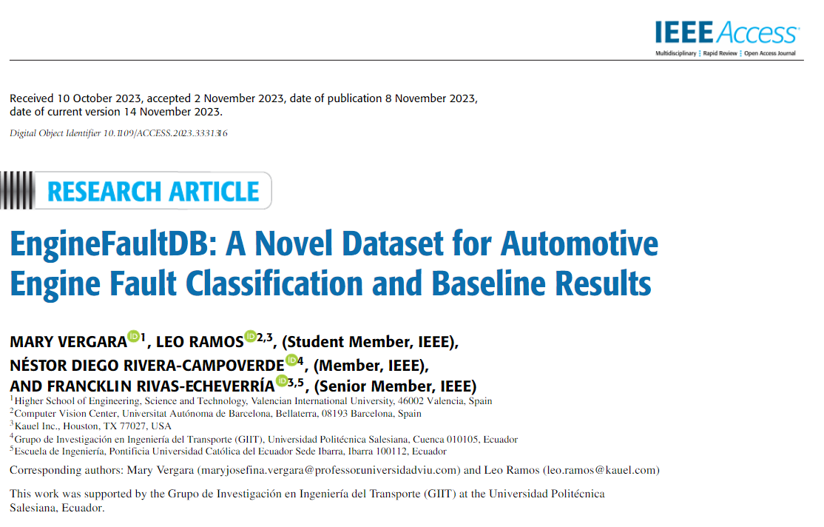
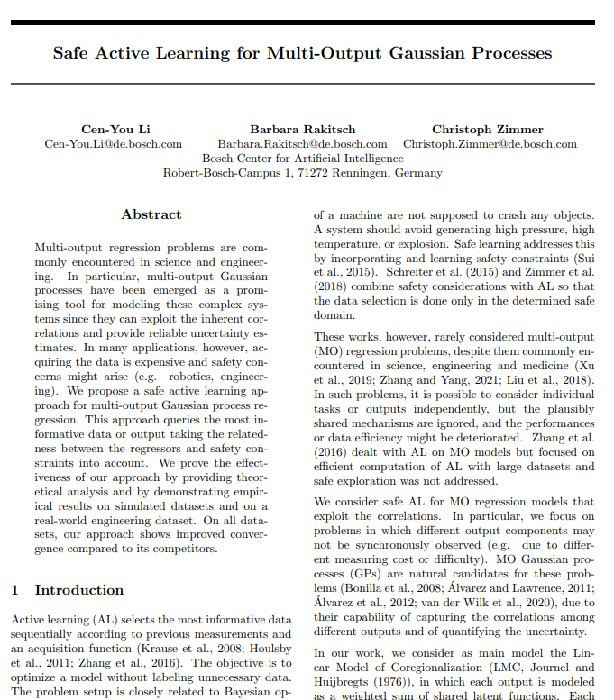
REFERNCES
Engine Fault Diagnosis
Baseline Survey – Journal & Datasets
Additional Research
[1] Vergara, M., Ramos, L., Rivera-Campoverde, N. D., & Rivas-Echeverría, F. (2023). Enginefaultdb: a novel dataset for automotive engine fault classification and baseline results. IEEE Access, 11, 126155-126171.
[2] Thomas, L. (2024). EngineFaultDB Dataset. GitHub. https://github.com/Leo-Thomas/EngineFaultDB
[5] Li, C. Y., Rakitsch, B., & Zimmer, C. (2022, May). Safe active learning for multi-output gaussian processes. In International Conference on Artificial Intelligence and Statistics (pp. 4512-4551). PMLR.
[6] Bosch Research. (n.d.). Bosch Engine Datasets. GitHub. https://github.com/boschresearch/Bosch-Engine-Datasets

